Slide 1
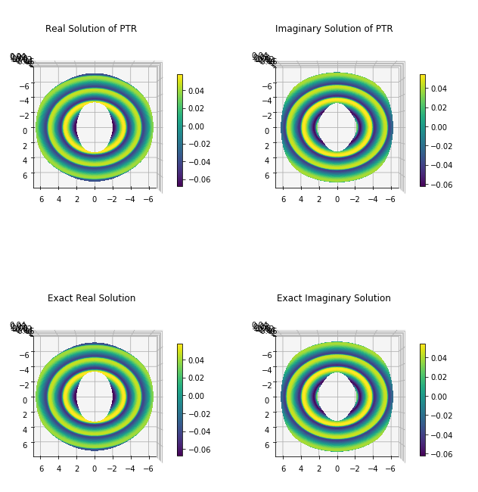
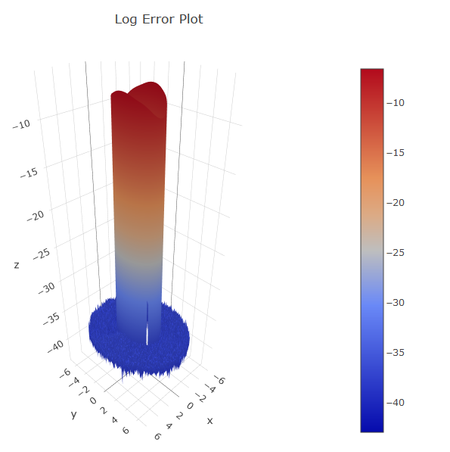
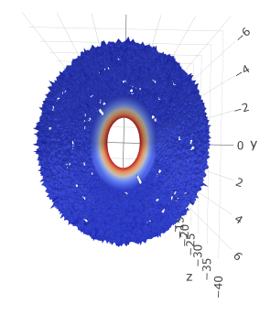
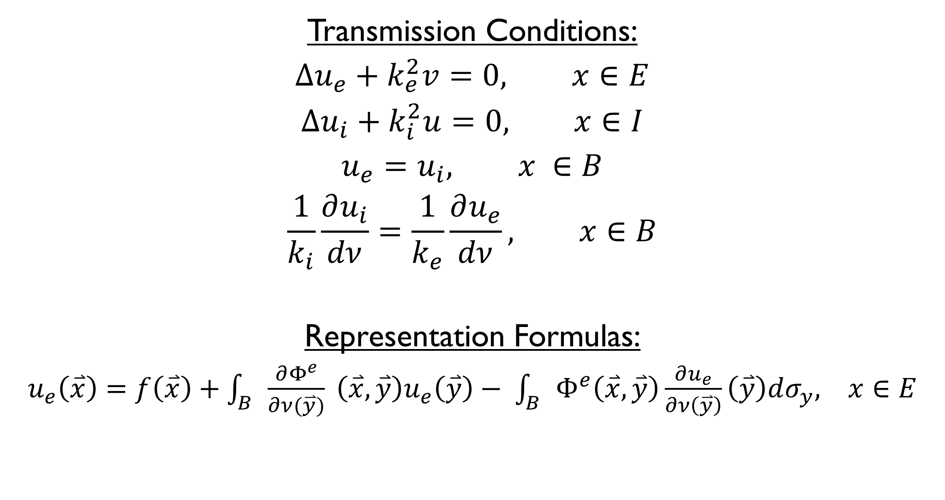
Cloaking using Periodic Trapezoid Rule Approximation of Boundary Integrals
Elsie A. Cortes, Camille Carvalho, PhD, School of Natural Sciences, University of California, Merced
Project Problem
Periodic Trapezoid Rule
Transmission
Our goal is to simulate cloaking by calculating the transversal of particles through a boundary. Because a cloaked object scatters particles more than an uncloaked object, we use a layered boundary to direct their incidence waves around the cloaked object. The periodic trapezoid rule is used to approximate the propagation of these waves.
Acoustic Scattering
pRELIMINARY
Conclusion
Transmission Conditions:
$$∆u_{e}+k_{e}^{2}v=0, x∈E$$
$$∆u_{i}+k_{i}^{2}u=0, x∈I$$
$$u_{e}=u_{i}, x ∈B$$
$$\frac{1}{k_{i}}\frac{∂u_{i}}{dν}=\frac{1}{k_{e}}\frac{∂u_{e}}{dν}, x∈B$$
Representation Formulas:
$u_{e}\left(\overset{⃑}{x}\right)=f\left(\overset{⃑}{x}\right)+\int_{B}{\frac{∂Φ^{e}}{∂ν(\overset{⃑}{y})}} \left(\overset{⃑}{x}, \overset{⃑}{y}\right)u_{e}\left(\overset{⃑}{y}\right)− \int_{B}{Φ^{e}\left(\overset{⃑}{x}, \overset{⃑}{y}\right)\frac{∂u_{e}}{∂ν\left(\overset{⃑}{y}\right)}\left(\overset{⃑}{y}\right)dσ_{y}, x∈E}$

